Slide 1
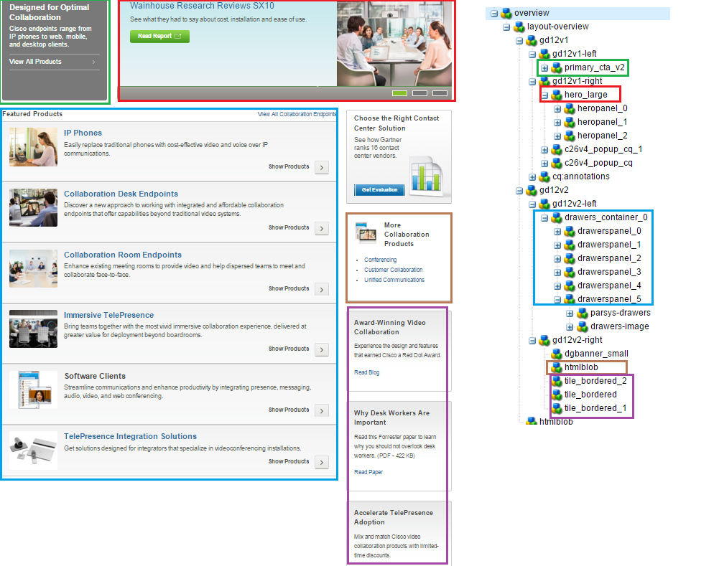
http://www.cisco.com/c/en/us/products/collaboration-endpoints/index.html
http://www.cisco.com/c/en/us/products/conferencing/index.html
http://www.cisco.com/c/en/us/products/routers/index.html
http://www.cisco.com/c/en/us/products/ switches /index.html
http://www.cisco.com/c/en/us/products/wireless/index.html
http://www.cisco.com/c/en/us/products/unified-communications/index.html

Slide 2
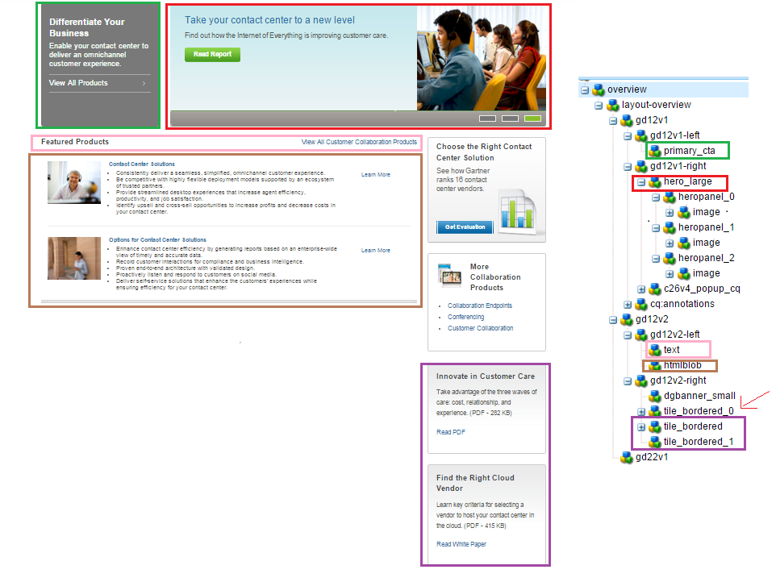
http://www.cisco.com/c/en/us/products/customer-collaboration/index.html

Slide 3
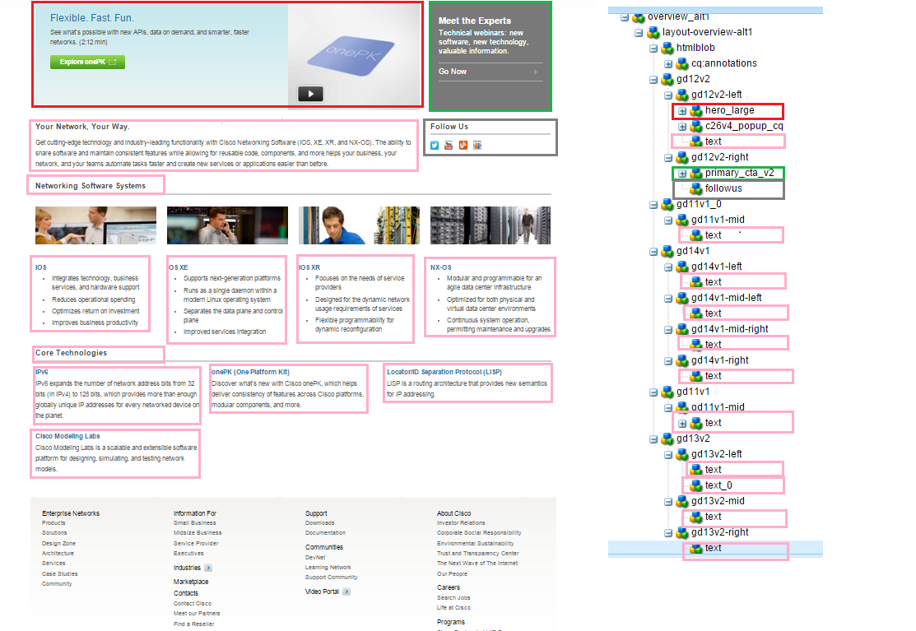
http://www.cisco.com/c/en/us/products/ios-nx-os-software/index.html

Slide 4
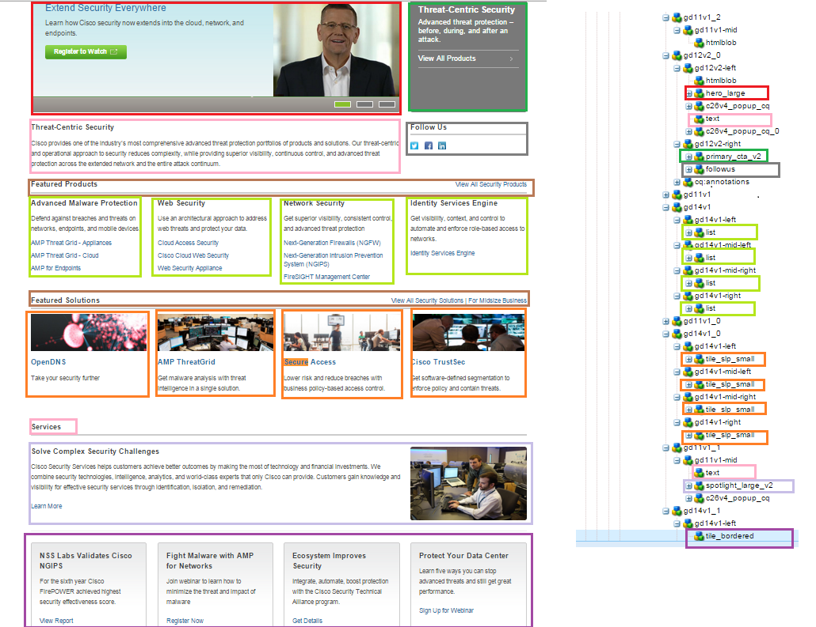
http://www.cisco.com/c/en/us/products/security/index.html

Slide 5
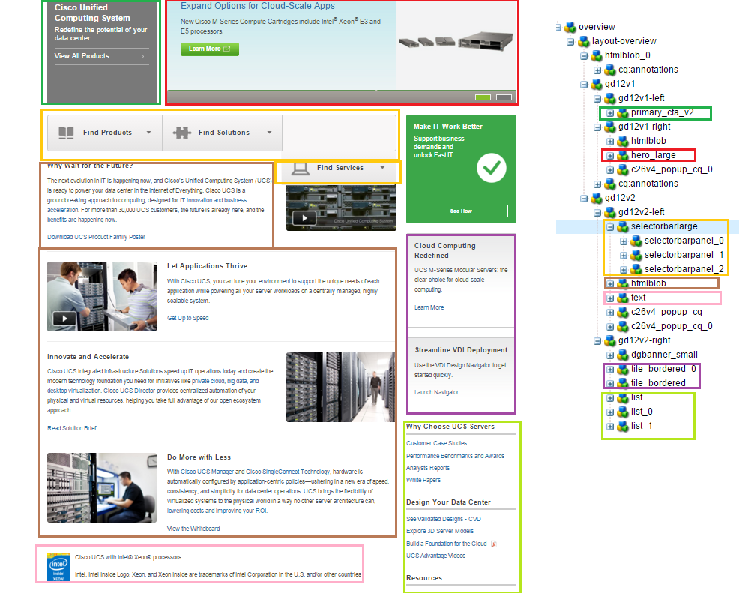
http://www.cisco.com/c/en/us/products/servers-unified-computing/index.html

Slide 6
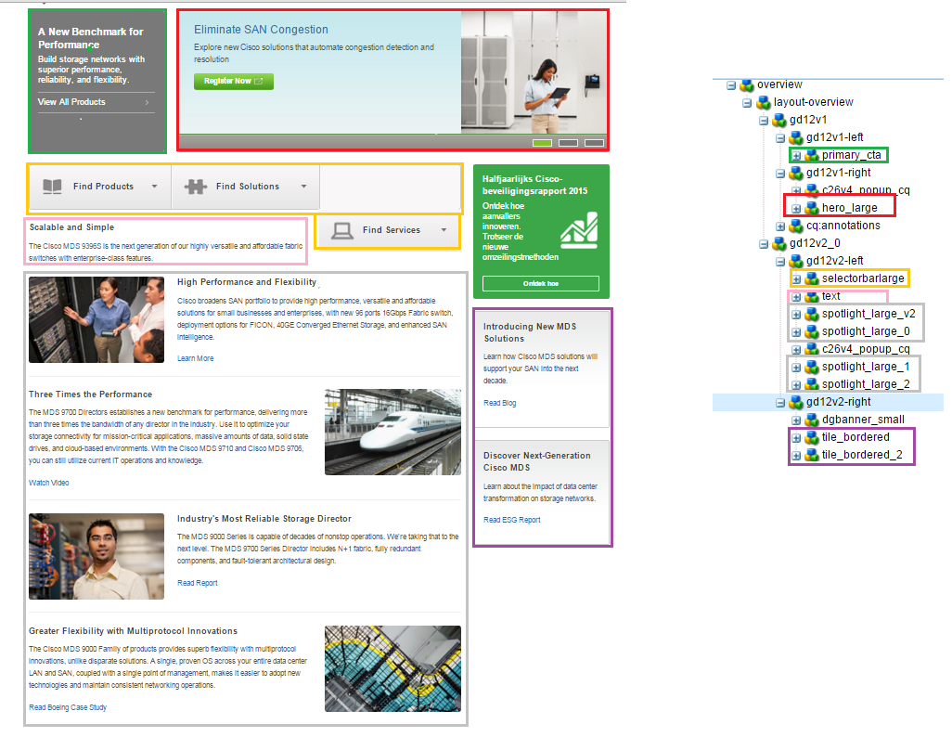
http://www.cisco.com/c/en/us/products/storage-networking/index.html

Slide 7
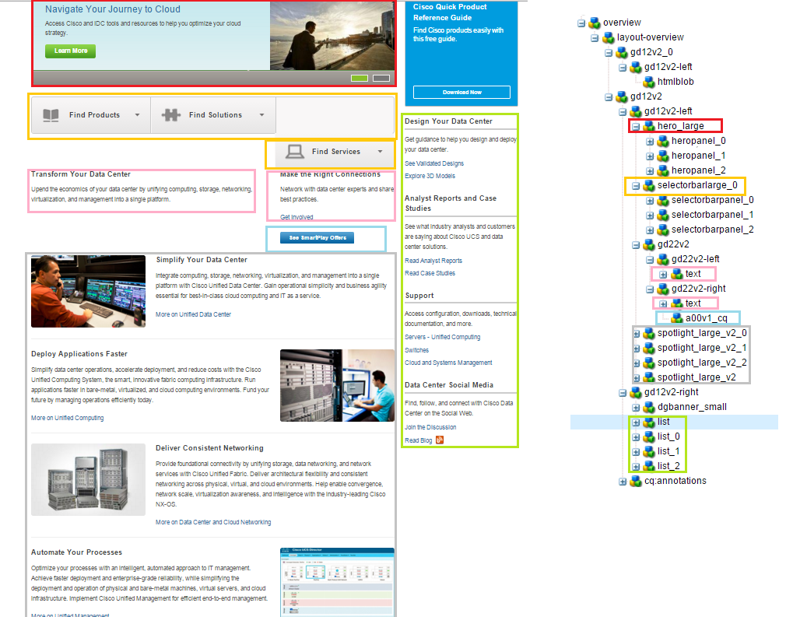
http://www.cisco.com/c/en/us/solutions/data-center-virtualization/index.html

Slide 8
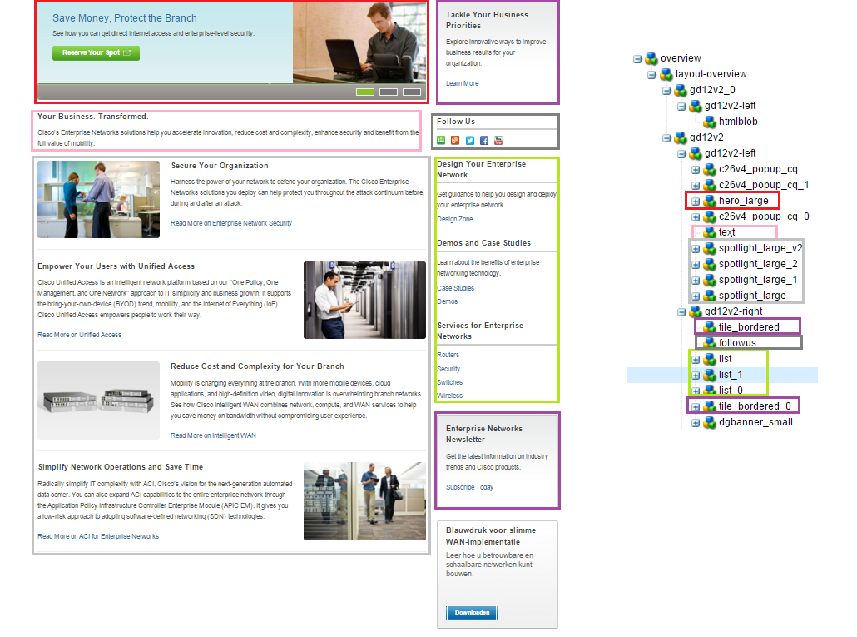
http://www.cisco.com/c/en/us/solutions/enterprise-networks/index.html

Slide 9
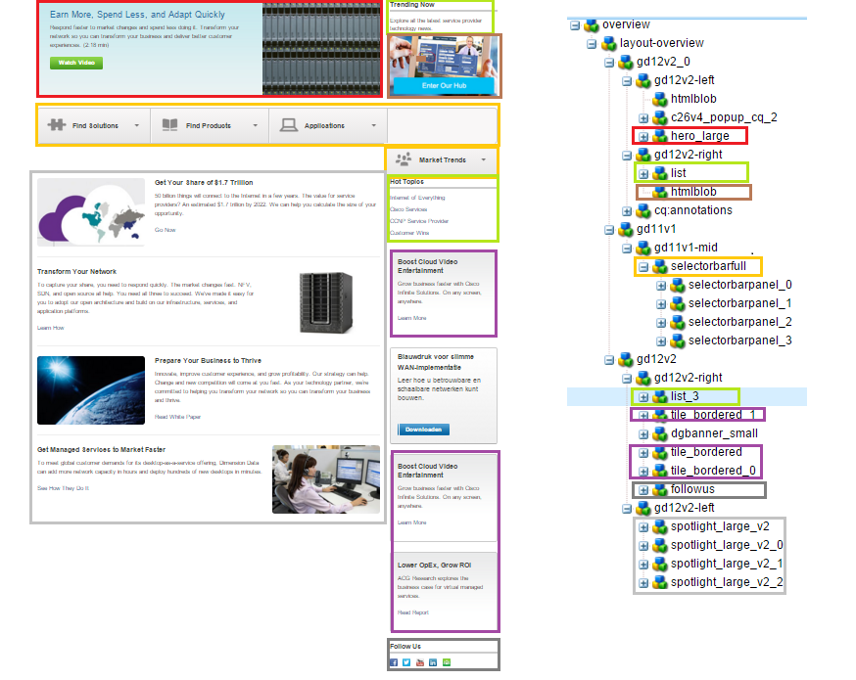
http://www.cisco.com/c/en/us/solutions/service-provider/index.html

